Slide 1

Scalable Event Ticketing & Seat Allocation System
A high-scalability system design for handling millions of concurrent users during flash-sale events
Ashmit Thakur

Slide 2

Problem Statement
The Challenge
Flash-sale ticketing platforms face critical issues when millions of users rush to purchase limited inventory:
Systems crash under massive traffic spikes during high-demand events
Overselling seats creates customer frustration and legal issues
Traditional architectures can't maintain consistency at scale
Our Objective
Design a distributed system comparable to Ticketmaster or BookMyShow that ensures strong seat consistency, low latency, and high scalability — with zero oversells guaranteed.

Slide 3
Key Performance Targets
<2s
<100ms
100K+
5K
p99 Checkout Latency
p50 Browse Latency
Concurrent Users
Reservations/sec
Fast transaction completion under peak load
Instant event discovery and seat exploration
Massive scale during flash sales
Sustained throughput capacity
99.95%
0
Uptime SLA
Oversells
High availability guarantee
Perfect inventory consistency

Slide 4

High-Level System Architecture
API Gateway
Catalog Service
Request routing, rate-limiting, authentication, and load balancing
Event metadata with eventual consistency for high read throughput
Seat Map Service
Cached real-time seat availability visualization
Reservation Service
Allocation Service
Temporary seat holds with strong consistency guarantees
Finalizes purchases and coordinates payment processing
Payment Adapter
Stripe/Razorpay integration with webhook handling
Orders Service
Reservation Queue
Persistent storage of confirmed transactions
Asynchronous processing for flash-sale traffic smoothing
Workers
Auto-scaling processors for queue consumption
The microservice architecture ensures independent scaling, fault isolation, and no single point of failure.

Slide 5

Data Model & Entity Relationships
Core Entities
Event → Venue → Seat
Hierarchical structure organizing event inventory by physical location and seating arrangements
Inventory Table
Tracks seat state per event: available, held, or sold with strong consistency
Reservation
Temporary holds with expiration timestamps (5-15 min TTL)
Order
Immutable record of completed purchases
PaymentRecord
Reconciliation with payment provider transactions
The Inventory table enforces atomicity using Compare-and-Set (CAS) operations, preventing double bookings even under concurrent access.

Slide 6
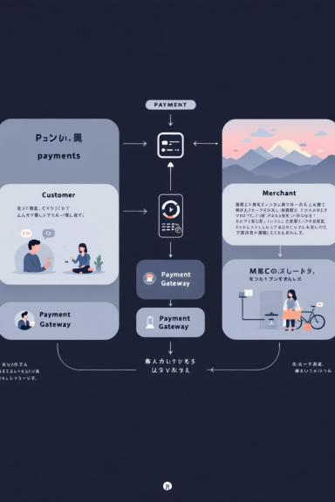




Reservation & Purchase Flow
Seat Selection
User chooses seats → Reservation Service attempts atomic CAS lock on Inventory records
Hold Confirmation
Reservation ID returned with expiration timer (5-15 minutes). Seats temporarily unavailable to others
Payment Processing
User commits purchase → Payment Adapter processes transaction via Stripe/Razorpay with idempotency keys
Completion
On success → Seats marked sold in Inventory, Order record created, confirmation sent to user
The CAS operation allows safe seat locking without global database locks, enabling horizontal scalability while maintaining zero oversells.

Slide 7






Handling Flash Sale Traffic
Scalability Strategies
Rate Limiting
Admission Queue
Auto-Scaling Workers
API Gateway enforces per-user and global limits to prevent abuse.
Redis/Kafka queue provides fair, first-come-first-served access during spikes.
Kubernetes HPA dynamically scales reservation processors based on queue depth.
Database Sharding
Aggressive Caching
Event-based sharding prevents single-database bottlenecks.
Redis caches seat maps and event metadata; CDN serves static assets.
Queues smooth traffic spikes, transforming bursty flash-sale demand into sustained, manageable load for downstream services.

Slide 8


Security & Transaction Reliability
PCI-DSS Compliance
Payment data tokenized via Stripe/Razorpay — no sensitive card data stored in our systems
Idempotency Keys
Every API request tagged with unique key prevents duplicate charges on retries or network failures
Webhook Verification
Payment provider webhooks cryptographically verified and deduplicated to prevent replay attacks
Admin Protection
Administrative actions restricted by VPN access, multi-factor authentication, and comprehensive audit logs

Slide 9
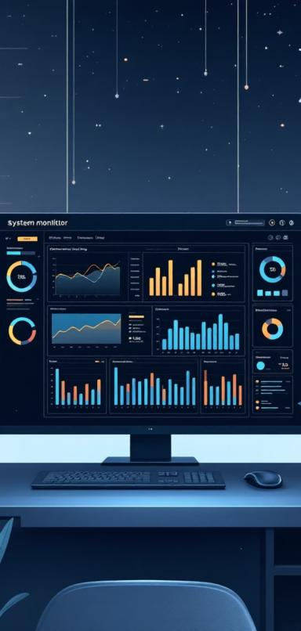






Capacity Planning & Monitoring
System Capacity
5K/s
2K/s
Reservation Requests
Commit Rate
Sustained throughput
Per second transaction processing
8-16
6-8
Database Shards
Redis Nodes
Per region allocation
Clustered for resilience
10+
Worker Instances
Auto-scaled capacity
Critical Metrics
Reservation Success Rate
Queue Depth
Percentage of successful seat locks vs. conflicts
Backlog size triggers auto-scaling events
Oversell Counter
p99 Latency
Real-time alerting on any consistency violations
Tail latency tracking across all services
Payment Success Rate
Transaction completion monitoring with provider reconciliation

Slide 10


Testing Strategy & Reliability
Load Test
Chaos Test
Simulate 20K RPS under flash load to ensure system stability and performance.
Intentionally kill coordinator nodes mid-sale to test resilience and recovery mechanisms.
Idempotency Test
Reconciliation
Verify the system can safely replay and re-process commits without unintended side effects.
Strictly verify no oversells or data inconsistencies occur during financial transactions.
Integration
Perform end-to-end testing of the complete checkout flow across all interconnected services.

Slide 11

Design Tradeoffs & Future Work
Pessimistic Lock
Optimistic CAS
Pros: Easy correctness
Pros: Scalable
Cons: Low scalability
Cons: Retry logic
Eventual Catalog
Pros: Fast reads
Cons: Slight delay
Future Work:
Dynamic pricing based on demand
Seat recommendation using AI
Blockchain-based ticket verification

Slide 12

Results & Conclusion
2s
0
99.95%
100K
P99 Latency
Oversells
Uptime
Concurrent Users
Achieved under 2 seconds
Recorded during testing
Guaranteed system availability
Seamlessly supported
“My system successfully meets real-world scalability goals — it’s modular, fast, and fault-tolerant.”

Slide 13

Thank You
We appreciate your time and attention. We are confident that this solution will exceed your expectations and provide a robust, scalable foundation for your future endeavors.

